Slide 1
03 | Simulation
Cynthia Rudin | MIT Sloan School of Management

Slide 2
Simulation
What happens when you have a random variable with a complicated distribution?
How do you compute probabilities like
P(X ≤ x)?
Notes:
This is a distribution that is so complicated that you can’t write it down exactly. You can write down what the random process is that generates the data, but you can’t write down its pdf. In that case,

Slide 3
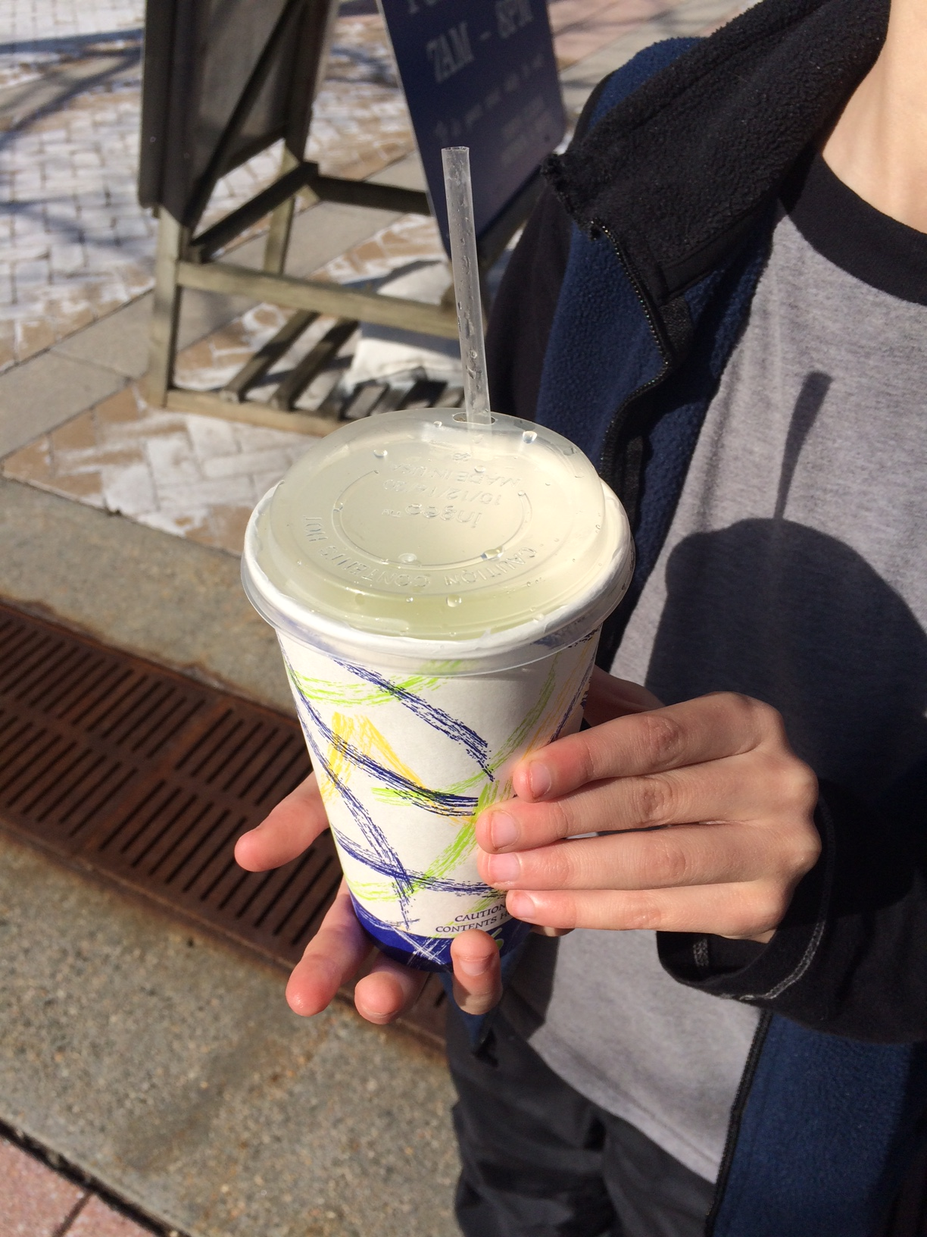
“The Squish”
Profit is a random variable, depends on:
Number of customers
Weather
Tips
Notes:
Maybe a few of you already knew this but over the summer, when classes are not in session, I run a chain of 9 lemonade stands operating currently throughout Boston Common over the spring and summer and a little into the fall. It’s called “The Squish” and we sell only lemonade, and it’s really good. Here’s a picture of one of my regular customers, it’s a 9 year old boy that visited pretty much every day in July and August last year, and it’s a customer happily drinking his lemonade. Now, in general, my profit for the day is a rv that depends on the number of customers I get that day, also the weather because we adjust the price of the lemonade depending on the weather, and then whatever tips the customer decides to leave for us. I’m going to tell you exactly how the profit depends on those things in a minute.

Slide 4
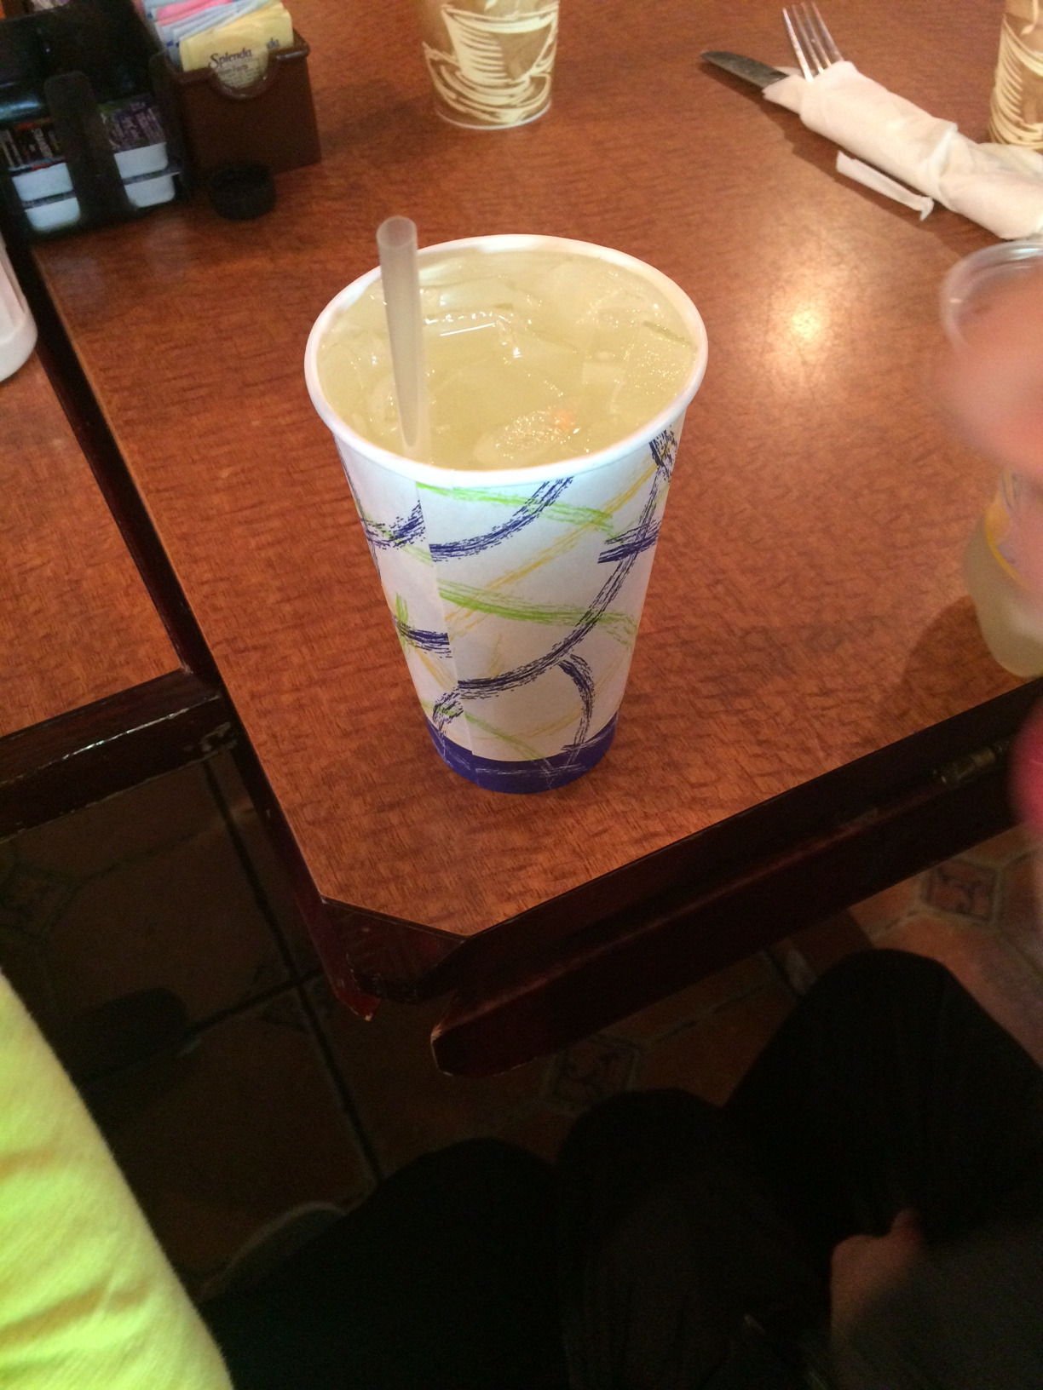
Simulation
What’s P(profit ≤ x)?
Profit comes from:
Notes:
Here’s the question I want to ask, which is what the probability is that the profit will fall below a particular value x, on a day sometime in July or August of next year. In order to answer this question, I will tell you exactly how my profit is calculated. It is the number of customers, times how much profit we make per cup, and then plus any tips that the customers want to give us.

Slide 5
NumCustomers ~ N(600,30²)
ProfitPerCup: discrete random variable
Tips: discrete random variable
 | Probability | Price
Good Weather | .3 | $5
Medium | .4 | $4
Bad Weather | .3 | $3.50
 | Probability | Tip
No tip | .5 | $0
Small tip | .2 | $0.25
Medium | .2 | $1
High | .1 | $2
Notes:
So here’s how I’m going to model the profit. I’ll say the number of customers comes from a normal distribution with mean 600 and sd 30. Why did I choose normal? Because customers are independent bernoulli’s. When you add up a bunch of independent rv’s, it looks normal according to the CLT. Ok. Now for the profit per cup, that depends on the weather. Because if the weather is hot, boy I can charge 5 whole bucks for a lemonade. But if the weather is bad, I can only justify charging $3.50. And for the tips, the customers give us whatever they want, but usually it’s easiest for them to give us whatever change they have, so they might give us nothing, or a quarter, or a bunck or two. Half the time they don’t give us any tip. Which is ok considering how much we’re charging for the lemonade. Anyway.

Slide 6
For each day, simulate:
NumCustomers ~ N(600,30²)
ProfitPerCup: discrete random variable
For each customer from 1:NumCustomer
Tip: discrete random variable
End For
End For
Notes:
So here’s how I’m going to simulate that on my computer. For each day, I’m going to simulate the number of customers from a normal distribution centered at 600 with sd 30. Then I’ll simulate the profit per cup as a discrete rv depending on the weather that day. I showed you the rvs distribution on the previous slide. Then for each customer, I’ll simulate the tip they’re going to give me. and that’s it. Using this code, I can simulate as many days as I like. Then I can use the simulation results to actually create a histogram to show what the distribution of my profits are going to look like. So let me show that to you.

Slide 7
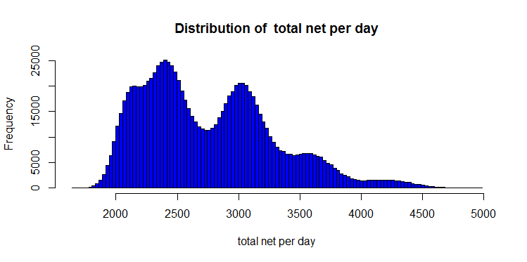
Notes:
And there it is. But why does it look like this? Where would all those bumps have come from? Why would the profits look like this? Let’s dissect it a bit more. Take a look at the simulation one more time.

Slide 8
Notes:
We have customers times profit per cup plus tips. What would happen if we removed the tips. I should think the tips kind of complicate the distribution. So let’s remove them for now.

Slide 9
Notes:
There is is. So I’ll redo the simulation but without the tips. Here goes.

Slide 10
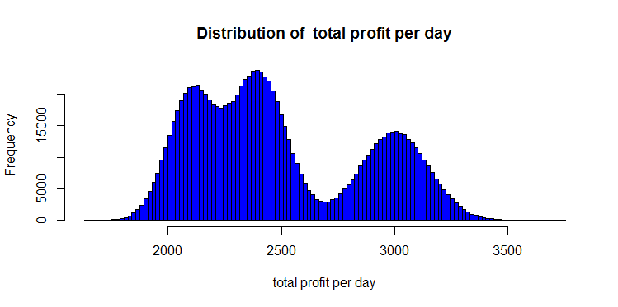
(Simulation With No Tips)
$3000=$5*600 people
Notes:
Oh now there’s 3 bumps. So why 3 bumps? I’ll give you a hint. If the lemonade is 5 bucks and 600 people purchase it, that’s 3000 bucks.

Slide 11
$2100=$3.50*600 people
$3000=$5*600 people
$2400=$4*600 people
Notes:
Now if we charge $4 then we’re here. And for 3.50, we’re here. So those three bumps are for different prices of lemonade that are possible. In the next slide, let’s just model the tips.

Slide 12
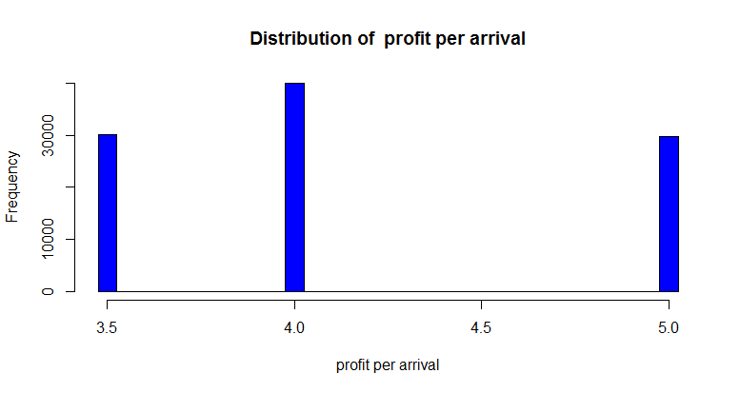

Slide 13
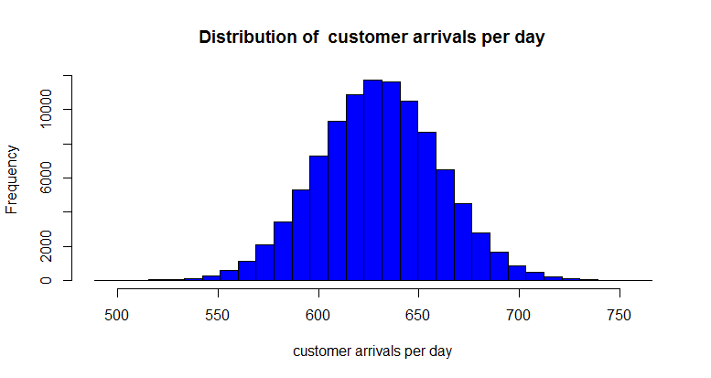

Slide 14
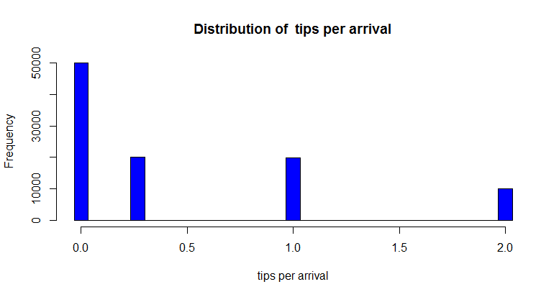

Slide 15
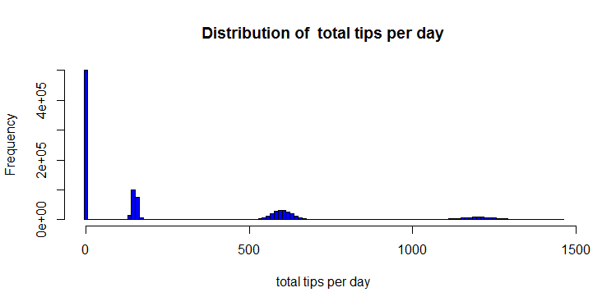
Notes:
The tips are here. Look at them - half the time they’re 0, but when they aren’t 0, they just add bumps at various places. They’ll create sort of ripple bumps throughout our histogram. And there won’t just be 4 bumps, they’ll be 4 bumps for each of the 3 prices of lemonade, so 12 bumps. Some of the bumps are going to be kind of small and will get schmeared out. So let’s see it all together again.

Slide 16
Notes:
And there it is. So now you know where it comes from! Two bumps here are sort of smushed because of the tips, and then this small bump out here is also because of the tips.
Now I can estimate probabilities really easily, if I want to know how often I will get less than 3000 profit, I just count the percent of days when I get less than 3000 profit.

Slide 17
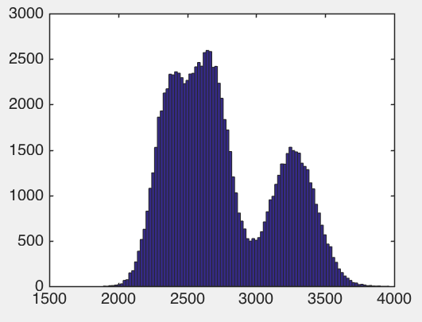
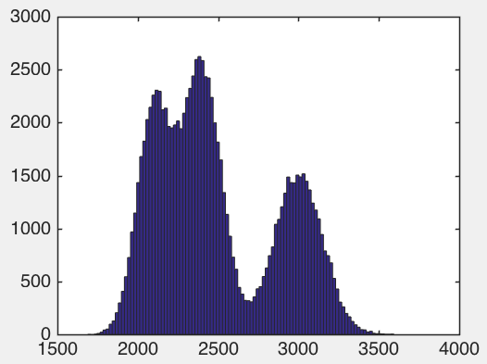
Tips
No tips

Slide 18
Notes:
Now I can estimate probabilities really easily, if I want to know how often I will get less than 3000 profit, I just count the percent of days when I get less than 3000 profit.

Slide 19
Notes:
Now I can estimate probabilities really easily, if I want to know how often I will get less than 3000 profit, I just count the percent of days when I get less than 3000 profit.

Slide 20
Notes:
if I want to know the probability to get between 2500 and 3500 profit, I just count the percent of days when I get between 2500 and 3500 profit in the simulation.

Slide 21
Simulating
Most software can simulate draws from
Normal
Bernoulli
Binomial
Uniform
Poisson
What about discrete?
Notes:
*read* how do you do that? It’s actually really simple.

Slide 22
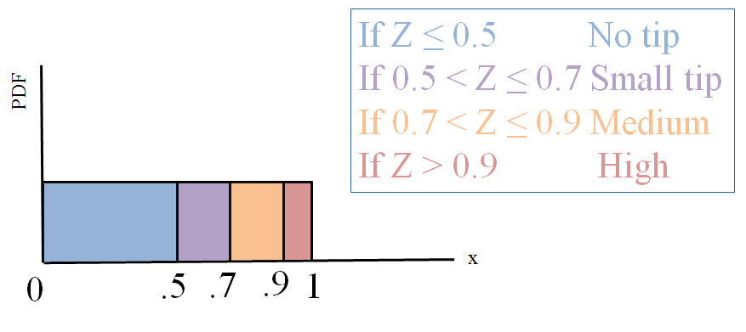
 | Probability | Tip
No tip | .5 | $0
Small tip | .2 | $0.25
Medium | .2 | $1
High | .1 | $2
Draw a uniform random number Z in [0,1].
Notes:
What you do is this. And I’ll do an example to demonstrate it. Let’s say I want to sample from the distribution of tips. With these probabilities up here. So I’ll draw a single uniform random number between 0 and 1. And then I’ll divide the interval up according to the probabilities. If my random number is less than .5, which happens half the time obviously, then I assign no tip. If the value is between .5 and .7, which happens with .2 probabilitiy, then assign a small tip and so on. And that’s it!

Slide 23
Simulation
Useful for answering:
What happens when you have a random variable with a complicated distribution?
How do you compute probabilities like P(X ≤ x)?
Notes:
*read1* This is a distribution that is so complicated that you can’t write it down exactly. You can write down what the random process is that generates the data, but you can’t write down its pdf. In that case, you can simulate from the distribution and at least you can see what it look like. And you can also use it to calculate estimated probabilities, which can be really useful.

Slide 24
02 | Confidence Intervals
Cynthia Rudin | MIT Sloan School of Management

Slide 25
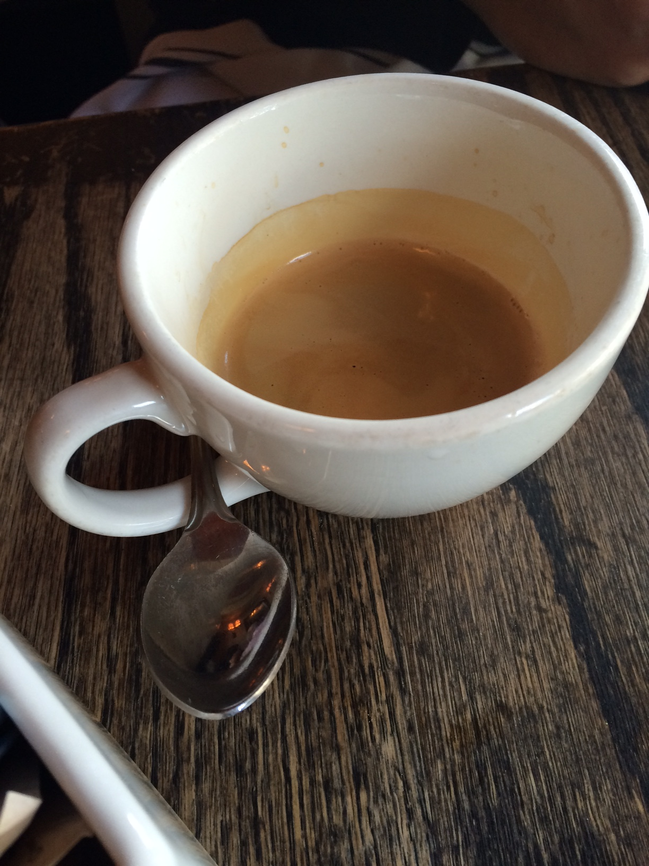
Confidence Intervals
What’s the average amount of coffee in a mug?
Notes:
The machine can’t pour exactly accurately, so there’s some distribution. I think it’s fair to guess that the distribution is approximately normal. Maybe that’s not fair, I’m not sure, but it seems that because of the central limit theorem, and the fact that a cup of coffee is a sum of lots of little drops of coffee that this would be ok.

Slide 26
Confidence Intervals
What’s the average amount of coffee in a mug?
1.26 1.01 0.97 1.04 …
Notes:
Steve helps me out by drinking 100 cups of coffee.
Now if I take the average of these numbers, how close is it to the population average? If I had him drink infinitely many mugs of coffee?

Slide 27
Confidence Intervals
What’s the average amount of coffee in a mug?
1.07
1.26 1.01 0.97 1.04 …
Notes:
Steve helps me out by drinking 100 cups of coffee.
Now if I take the average of these numbers, how close is it to the population average? If I had him drink infinitely many cups of coffee?

Slide 28
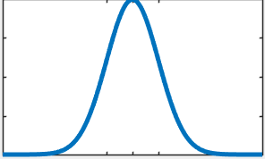
Confidence Intervals
What’s the average amount of coffee in a mug?
1.07
1.26 1.01 0.97 1.04 …
Notes:
Steve helps me out by drinking 100 cups of coffee.
Now if I take the average of these numbers, how close is it to the population average? If I had him drink infinitely many cups of coffee?

Slide 29
Confidence Intervals
What’s the average amount of coffee in a mug?
1.07
1.26 1.01 0.97 1.04 …
Notes:
Steve helps me out by drinking 100 cups of coffee.
Now if I take the average of these numbers, how close is it to the population average? If I had him drink infinitely many cups of coffee?

Slide 30
Confidence Intervals
What’s the average amount of coffee in a mug?
1.07
1.26 1.01 0.97 1.04 …
Notes:
Steve helps me out by drinking 100 cups of coffee.
Now if I take the average of these numbers, how close is it to the population average? If I had him drink infinitely many cups of coffee?

Slide 31
Confidence Intervals
What’s the average amount of coffee in a mug?
1.07
1.26 1.01 0.97 1.04 …
Notes:
Steve helps me out by drinking 100 cups of coffee.
Now if I take the average of these numbers, how close is it to the population average? If I had him drink infinitely many cups of coffee?

Slide 32
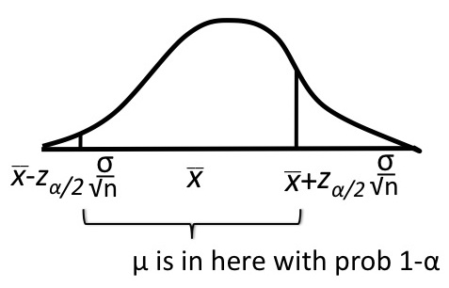
Confidence Intervals
What’s the average amount of coffee in a mug?

Slide 33
Confidence Intervals
What’s the average amount of coffee in a mug?

Slide 34
Confidence Intervals
What’s the average amount of coffee in a mug?
Notes:
I can tell you exactly what that interval is but it has a bunch of symbols in it that you don’t know, so let me explain that and get back to this.

Slide 35
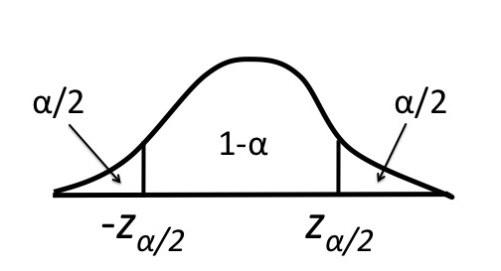
Notes:
Let’s start with the standard normal, so mean 0 and standard deviation 1. I’m going to ask you some questions about this distribution.

Slide 36
1
Notes:
I want to know…. If I draw a point from this distribution, What is the probability it will be more than 1 standard deviation above the mean? Remember, probabilities are areas... here. So what do you think the answer is?

Slide 37
.1587
1
Notes:
Turns out it’s about 15.87% chance. Unfortunately there’s no formula that people can write down to get you from 1 to 15%. The problem is that there’s no analytical form for the area under the normal distribution. Remember, probabilities are integrals.. here. But this is a case where we can’t compute the integral using a formula. That’s ok, we have a lookup table in the computer. Any software you use will have a command that gets you between these things. So,

Slide 38
.1587
Notes:
If you know that this probability is 15%,

Slide 39
.1587
1
Notes:
The computer can tell you this corresponds to 1 standard deviation above the mean.

Slide 40
Notes:
And it works for any alpha and z alpha. This is the usual notation. Alpha is the area (that is, the probability), and z_alpha is the corresponding z score. Zalpha is the number of standard deviations above or below the mean.

Slide 41

-.5
Notes:
. If you give me zalpha, whatever it is

Slide 42
.6915
-.5
Notes:
There’s only one possible alpha that corresponds to it, and that’s in the computer’s look up table.

Slide 43
Notes:
There’s a one-to-one correspondence, which means that if you know alpha, you know zalpha and vice versa

Slide 44
Notes:
Ok so I hope you get the point. If you have the zscore, you have the probability to be above it. *pause*
Now there’s this cool little trick that people use for notation. You see, the standard normal has mean 0. So if you know alpha and zalpha, you automatically know the answer to this one:

Slide 45
Notes:
If this is alpha, What then is the z that corresponds to this?
And because the standard normal is symmetric, the answer is

Slide 46
Notes:
Actually –zalpha.

Slide 47
Notes:
Sometimes people like to ask questions about whether something is unusual, meaning it could be in one tail of the distribution or the other. In that case, they usually say that things are ok 1-alpha of the time. Then the probability of being unusual is alpha, and that probability gets split between the two tails. So again you’re this many standard deviations above the mean with probability alpha/2.

Slide 48
Confidence Intervals
What’s the average amount of coffee in a mug?
1.07
1.26 1.01 0.97 1.04 …
Notes:
Ok so I think we’re ready to go back to confidence intervals! You want to know what’s the average amount of coffee in a cup. You make n measurements, the sample average of which is 1.07 cups.

Slide 49
Confidence Intervals
What’s the average amount of coffee in a mug?
Notes:
And now I can tell you the answer because now you’ll understand it. Here’s the formula. You have data coming from a normal distribution, with a known standard deviation sigma, and you have n observations. With probability alpha, the true population mean mu is within this interval right here.

Slide 50
Confidence Intervals
Notes:
I can say it again a different way.

Slide 51
Confidence Intervals
Notes:
Confidence intervals come in two other flavors, called “one sided”. What I just showed you was a 2 sided confidence interval.

Slide 52
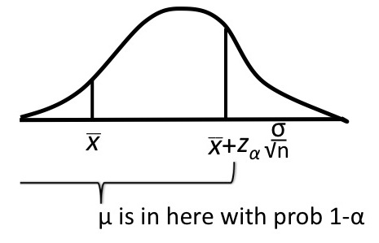
Confidence Intervals
Notes:
This is called upper one-sided because it provides an upper bound for mu.

Slide 53
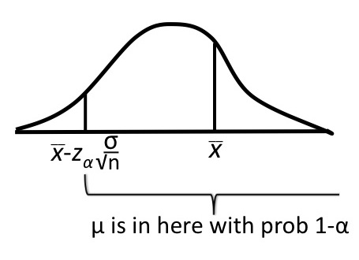
Confidence Intervals
Notes:
This one is called lower one-sided

Slide 54
2-sided
Lower 1-sided
Upper 1-sided
Notes:
Now I hope at least some of you are saying to yourselves “but all of this us useless! Since I don’t actually know the true standard deviation sigma, I can’t plug anything into this formula!” Well that would be true. BUT
The good news is that the sample standard deviation s converges very quickly to the true standard deviation sigma, so as long as you have enough data, it’s pretty safe to plug in the sample standard deviation s instead of sigma. Remember, s you can calculate, whereas sigma you can’t.
The other piece of good news is that there’s a way to change this confidence interval just a little bit so that it has only an s in it and not a sigma. There are lots of other kinds of confidence intervals

Slide 55
Confidence Intervals
Confidence intervals on:
Mean
Variance
Proportion
…

Slide 56
Confidence Intervals
Quantifies uncertainty about the population.
Notes:
So why do you care as a data scientist? Because what you can do for people now is to quantify the uncertainty. If you tell someone,

Slide 57
Next year
You will earn $300,000
Notes:
You will make 300,000 bucks. Are they going to be believe you? Prolly not. The chance that you’ll make exactly 300,000 is almost exactly 0. But how much will you make?

Slide 58
Next year
You will earn $300,000
Notes:
If they say you’ll make 300K +/- 200K, well, that’s not a very certain estimate is it. But if they say

Slide 59
Next year
You will earn $300,000
Notes:
This, then that’s a totally different story. It’s much more certain.

Slide 60
Confidence Intervals
Quantifies uncertainty about a parameter of the population.

Slide 61
03 | Hypothesis Testing
Cynthia Rudin | MIT Sloan School of Management
Notes:
Hypothesis testing is obviously a key topic in statistics. Hypothesis tests are used as a sort of data-centered technique to prove that something is true beyond a reasonable doubt. There’s been a lot of controversy over hypothesis tests lately. There was a psychology journal that banned pvalues recently, and there was some real debate over this, sort of culminating with a letter from the American statistical association explaining what pvalues actually are and what they are not, warning people not to mess it up. There are multimillion dollar decisions being made based on pvalues every day. What drugs are safe for you to take, that depends somewhat on pvalues, and there are lawsuits every day about the interpretation of these pvalues. So let’s discuss it in a way that you can not only use it in your toolbox, but know when someone is using it incorrectly in theirs.

Slide 62
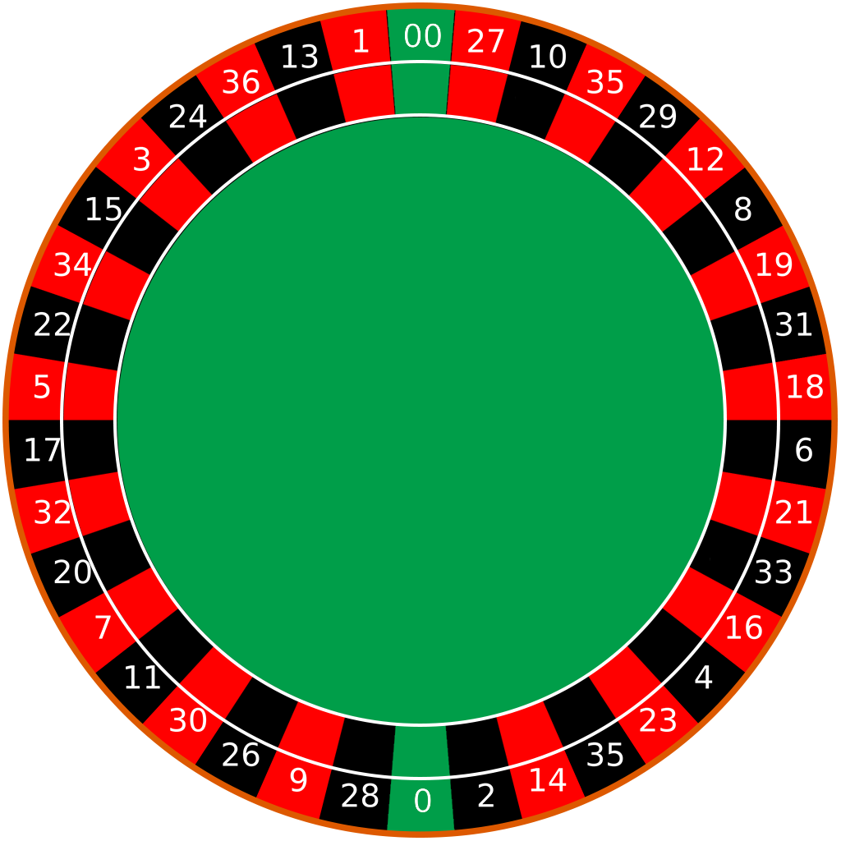
Risky Gambling
Bet on black. The probability to win is 18/37=.4865
She bets 20 times. She won 4 games.
The probability to get 4 wins (or less) is .0082.
Notes:
Let’s start with an example. Your friend likes to go to a casino that you think might do some shady deals. In fact you would not be surprised if they have interesting ways of cheating you out of money. A regular casino has an edge, but this one possibly has a mega edge. So you go there with your friend, she bets on black 20 times and wins 5 games. Now she wants to go play more games, but you tap her on the shoulder and say – hey can I talk to you? Just for a second. Your friend is so intent on playing that she doesn’t want to quit, but after some more annoying tapping on the shoulder, she finally relents, and you whisper something to her. Takes 2 seconds. She turns around, and sure enough, she walks away and doesn’t play again. So what did you say to her?

Slide 63
Risky Gambling
Bet on black. The probability to win is 18/37=.4865
She bets 20 times. She won 4 games.
Notes:
Let’s start with an example. Your friend likes to go to a casino that you think might do some shady deals. In fact you would not be surprised if they have interesting ways of cheating you out of money. A regular casino has an edge, but this one possibly has a mega edge. So you go there with your friend, she bets on black 20 times and wins 5 games. Now she wants to go play more games, but you tap her on the shoulder and say – hey can I talk to you? Just for a second. Your friend is so intent on playing that she doesn’t want to quit, but after some more annoying tapping on the shoulder, she finally relents, and you whisper something to her. Takes 2 seconds. She turns around, and sure enough, she walks away and doesn’t play again. So what did you say to her?

Slide 64
Risky Gambling
Bet on black. The probability to win is 18/37=.4865
She bets 20 times. She won 4 games.
The probability of 4 wins (or less) is .0082.
Notes:
Let’s start with an example. Your friend likes to go to a casino that you think might do some shady deals. In fact you would not be surprised if they have interesting ways of cheating you out of money. A regular casino has an edge, but this one possibly has a mega edge. So you go there with your friend, she bets on black 20 times and wins 5 games. Now she wants to go play more games, but you tap her on the shoulder and say – hey can I talk to you? Just for a second. Your friend is so intent on playing that she doesn’t want to quit, but after some more annoying tapping on the shoulder, she finally relents, and you whisper something to her. Takes 2 seconds. She turns around, and sure enough, she walks away and doesn’t play again. So what did you say to her?

Slide 65
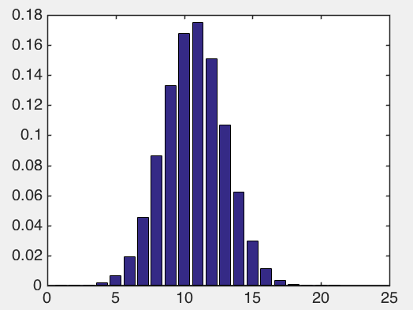
Risky Gambling
Bet on black. The probability to win is 18/37=.4865
She bets 20 times. She won 4 games.
The probability of 4 wins (or less) is .0082.
Notes:
So what’s going on here? This is the binomial distribution for N=20 and p=.48. The probability to win 10 games is pretty high, it’s like 16 some percent chance to win exactly 10 games. But to win 4 games?

Slide 66
Risky Gambling
Bet on black. The probability to win is 18/37=.4865
She bets 20 times. She won 4 games.
The probability of 4 wins (or less) is .0082.
Notes:
The probability of 4 wins is really small, and even if you add up the probability of getting 4, 3, 2, 1, or 0 wins, it’s less than 1%. So there’s something wrong, the chance that this is a fair roulette game at this point is pretty small.

Slide 67
Risky Gambling
Bet on black. The probability to win is 18/37=.4865
Notes:
Ok refresh. What you said to your friend got the point across but let’s say you had time not only to whisper 1 sentence in her ear, but you had a few minutes to do it. Then you could explain things a bit more thoroughly.
You tell her, psst I’m going to set up a hypothesis test. The null hypothesis is that everything is as it should be. The roulette wheel will give you a .48 chance of winning if you bet on black.

Slide 68
Risky Gambling
Bet on black. The probability to win is 18/37=.4865
Null Hypothesis H₀
is the claim of “no difference.”
Alternative Hypothesis H₁
is the claim we are trying to prove.
Notes:
In general the null hypothesis is that everything is behaving as the status quo, as you would expect it to behave. Got that terminology? Null hypothesis is the claim that everything is as you’d expect it to be if things were fair. Here, the null hypothesis is that the casino is playing fair, and the probability to win is .4865.

Slide 69
Risky Gambling
Bet on black. The probability to win is 18/37=.4865
Null Hypothesis H₀
is the claim of “no difference.”
Alternative Hypothesis H₁
is the claim we are trying to prove.
Notes:
Now the alternative hypothesis is the claim we are trying to prove. Here, we’re trying to prove that the casino is not playing fairly, that the probability to win on black is below .4865.

Slide 70
Risky Gambling
Bet on black. The probability to win is 18/37=.4865
Null Hypothesis H₀
is the claim of “no difference.”
Alternative Hypothesis H₁
is the claim we are trying to prove.
The probability to win is below .4875
Notes:
Now the alternative hypothesis is the claim we are trying to prove. Here, we’re trying to prove that the casino is not playing fairly, that the probability to win on black is below .4865. *pause*

Slide 71
Risky Gambling
Bet on black. The probability to win is 18/37=.4865
She bets 20 times. She won 4 games.
The probability of 4 wins (or less) is .0082.
Notes:
Now your friend needs to figure out at what point she stops believing that the casino is fair and that she’s just having bad luck. Here clearly something is up. That’s not just bad luck, we can be pretty sure that the casino is cheating and the wheel is rigged. But what if…

Slide 72
Risky Gambling
Bet on black. The probability to win is 18/37=.4865
She bets 20 times. She won 6 games.
The probability of 6 wins (or less) is .0730.
Notes:
If she had won 6 games, then it’s more likely that the casino was playing fair, and she would have had a 7.3% chance to get something that extreme. Maybe at that point she would have brushed you off and sat back down to the table again. Because there’s a reasonable chance that could have happened randomly, and the wheel is indeed fair.

Slide 73
Risky Gambling
Bet on black. The probability to win is 18/37=.4865
She bets 20 times. She won 6 games.
The probability of 6 wins (or less) is .0730.
p-value
Notes:
This thing over here is called the p-value. The p-value is the probability to observe something at least as extreme as what you actually saw. That assumes the null hypothesis is true.

Slide 74
Risky Gambling
The p-value is the probability to observe something as extreme as what you observed,
The probability of 6 wins (or less) is .0730.
p-value
Notes:
Here I have a definition. *Read* When we say extreme, we mean extreme relative to the null hypothesis, so I will put that there explicitly.

Slide 75
Risky Gambling
The p-value is the probability to observe something as extreme as what you observed, under the null hypothesis.
The probability of 6 wins (or less) is .0730.
p-value
Notes:
*Read*

Slide 76
Risky Gambling
The probability of 6 wins (or less) is .0730.
The p-value
p-value
Notes:
If you want to see it visually, the p-value is the area of that tail of the probability distribution, which tells us how extreme our data are. Obviously that distribution comes from the null hypothesis, which says that the probability of success is .48. So the null hypothesis tells us what we should expect, tells us the definition of the probability density function for what’s usual behavior. Then the p-value tells us how unusual that behavior is.

Slide 77
Risky Gambling
The probability of 4 wins (or less) is .0082.
The probability of 6 wins (or less) is .0730.
Notes:
*read* So how unlikely do things need to be in order for your friend to believe you that the roulette wheel is rigged? If she gets something that’s less than 1% likely to happen, she might really believe that the wheel is rigged. If she’s in the top 7 percent on the other hand, that might not be so unreasonable.

Slide 78
Risky Gambling
The probability of 4 wins (or less) is .0082.
The probability of 6 wins (or less) is .0730.
.0082
.0730
.15
.50
Notes:
I put a bunch of numbers on this number line, including .0082 which we decided would be totally unreasonable, we’d leave the casino if that happened. I put on 7.3%, where we might stay at the casino and call it possibly fair. Then I put also 15% and 50%, obviously these are events that could have happened more easily by random luck. Now

Slide 79
Risky Gambling
.0082
.0730
.15
.50
Notes:
I’m going to draw a line, and I’ll say below that value it’s going to be unreasonable and above it it’s going to be reasonable. At least within the realm of possibility.

Slide 80
Risky Gambling
.05 ⬅ significance level
.0082
.0730
.15
.50
Notes:
I stretched it out a little bit. Remember the distribution there represents the null hypothesis, which is a .48 probability of success each time you spin the wheel. If what I observed was so unlikely to happen that it ends up in that tail, then I say that the null hypothesis is rejected.

Slide 81
Risky Gambling
.05 ⬅ significance level
.0082
.0730
.15
.50
Notes:
The significance level is predetermined. Here I chose .05 which is the most common significance level, but there’s nothing special about this choice, you could choose whatever you want to really. The idea is that if circumstances are so unusual that the probability of them happening is below the significance level, (5%) than we can finally say “something’s not as is should be here”. The null hypothesis can’t possibly be true. What we’ve seen is too unusual. It’s not within the 95% realm of possibility. The significance level tells you what decision to make, whether to reject the null hypothesis or not.

Slide 82
Outline for Tests
Define the null hypothesis H₀ and alternative hypothesis H₁.

Slide 83
Outline for Tests
Define the null hypothesis H₀ and alternative hypothesis H₁.
H₀: p=18/38
H₁: p<18/38
Notes:
Here we were looking for the test to give us an unusually small number of wins which means the probability is below 18/38.

Slide 84
Outline for Tests
Define the null hypothesis H₀ and alternative hypothesis H₁.
H₀: p=18/38
H₁: p<18/38
Notes:
So we’re looking at this tail of the distribution.

Slide 85
Outline for Tests
Define the null hypothesis H₀ and alternative hypothesis H₁.
H₀: p=18/38
H₁: p>18/38
Notes:
But we could look at the alternative hypothesis being that the wheel makes us win too often to be a standard wheel, in which case we’d look for an unusually high number of wins, say above 15 or 16 wins.

Slide 86
Outline for Tests
Define the null hypothesis H₀ and alternative hypothesis H₁.
H₀: p=18/38
H₁: p≠18/38
Notes:
Or we could say it’s unusual to get either too small or too high wins, in which case we have a hypothesis test like this. Where the alternative hypothesis is that p is not equal to 18/38.

Slide 87
Outline for Tests
Define the null hypothesis H₀ and alternative hypothesis H₁.
Notes:
This whole procedure can be repeated for many different kinds of tests. Here we were working on a single sample test using the binomial distribution as the null. But you can create tests for other types of hypotheses. You want to kind of follow this outline though. First you define the null hypothesis H0 which defines this probability distribution and then define H1 which tells you what tail of the distribution you’re going to be looking at (or you could look at both tails).

Slide 88
Outline for Tests
Define significance level α
α=0.05
Notes:
Then you define the significance level, which tells you what decision you’re going to make after you see your data. The significance level tells you what is in the realm of the usual. Most of the time I choose a 0.05 significance level so no one asks me why I chose something different, but there’s nothing special about 0.05 really.

Slide 89
Outline for Tests
From your data, calculate the test statistic and p-value. Reject if pvalue < α. Otherwise don’t reject.
p-value=0.073
Notes:
Then you calculate the pvalue, and
If you don’t reject the null hypothesis, it doesn’t mean that the null hypothesis is true. In our case, if we have 6 successes out of 20, with a pvalue of 7%, we might not be able to say for sure that the wheel is unfair… but certainly the wheel could be unfair! We just didn’t get enough evidence to prove it.

Slide 90
Hypothesis Testing
Assume H₀ is true. Does the data contradict the assumption beyond a reasonable doubt?
If yes: accept H₁ and reject H₀.
If no: H₀ can’t be ruled out as an explanation for the data. In this case we can’t accept any hypothesis.
Analogy: Presumed innocent until proven guilty
H₀: not guilty
H₁: guilty
Notes:
To summarize
Does the data contradict H0? If yes, then rule as guilty. If no, it doesn’t mean the person is innocent but evidence is insufficient to establish guilt, it gives the person the benefit of the doubt.

Slide 91
Other Types of Tests
Notes:
Hypothesis testing is obviously a key topic in statistics. Hypothesis tests are used as a sort of data-centered technique to prove that something is true beyond a reasonable doubt. There’s been a lot of contraversy over hypothesis tests lately. There was a psychology journal that banned pvalues recently, and there was some real debate over this, sort of culminating with a letter from the American statistical association explaining what pvalues actually are and what they are not, warning people not to mess it up. There are multimillion dollar decisions being made based on pvalues every day. What drugs are safe for you to take, that depends somewhat on pvalues, and there are lawsuits every day about the interpretation of these pvalues. So let’s discuss it in a way that you can not only use it in your toolbox, but know when someone is using it incorrectly in theirs.

Slide 92
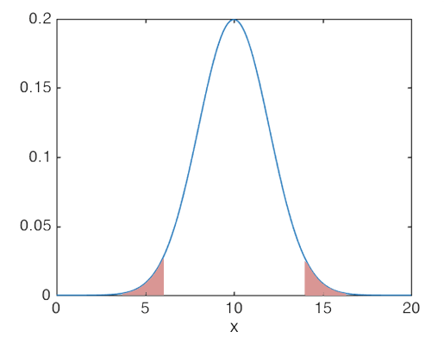
H₀: μ=10
H₁: μ≠10
Data: 11.1, 9.4, 9.9, 13.3, 10.3, …
Notes:
Let’s say my lemonade dispenser is supposed to produce 10 units of lemonade and I want to do a hypothesis test to determine whether the machine is broken, meaning it is dispensing either too much or too little lemonade. Then I can do a hypothesis test and check on that. The null hypothesis is that the machine is performing according to specifications, which is that amount of lemonade is normal, with a mean of 10 units, with a standard deviation of say 2 units or something. The alternative is that the mean is not equal to 10 units. Then you can perform a hypothesis test by calculating probabilities using the normal distribution. You don’t have to do this yourself, you just need to know what the test is called. So you can call the right function on the computer. If the test uses the normal distribution, it’s called a z-test.

Slide 93
H₀: μ=10
H₁: μ≠10
Data: 11.1, 9.4, 9.9, 13.3, 10.3, …
z-test
Notes:
Now, doing a z-test on a computer is really easy.

Slide 94
z-test
The inputs are:
Data: 11.1, 9.4, 9.9, 13.3, 10.3, …
Null hypothesis: μ=10, σ=3
Alternative hypothesis: ‘right’ tail (or ‘left’ or ‘both’)
Significance level: α=0.05.
Outputs are:
reject or not
p-value
(confidence interval, z-score)

Slide 95
z-test
The inputs are:
Data: 11.1, 9.4, 9.9, 13.3, 10.3, …
Null hypothesis: μ=10, σ=3
Alternative hypothesis: ‘right’ tail (or ‘left’ or ‘both’)
Significance level: α=0.05.
Outputs are:
reject or not
p-value
(confidence interval, z-score)
Notes:
Of course as you noticed, you have to know sigma to do a z-test. That’s great if you know sigma or can estimate it pretty well, but what if you don’t? Then you do a t-test

Slide 96
t-test
For small samples from a normal distribution with unknown variance.

Slide 97
H₀: μ=10
H₁: μ≠10
Data: 11.1, 9.4, 9.9, 13.3, 10.3, …
z-test
Notes:
See, if you know the variance, you can do a z-test. But if you don’t know it, are you totally stuck? No, thanks to William Sealy Gosset.

Slide 98
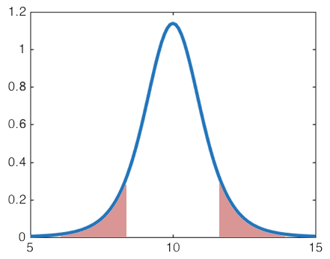
H₀: μ=10
H₁: μ≠10
Data: 11.1, 9.4, 9.9, 13.3, 10.3, …
This is a t distribution, not a normal distribution
Notes:
Gosset was a really interesting guy. He was working for Guiness brewing company, who wouldn’t let him publish anything because they didn’t want to release trade secrets. So he published under the pen name of student. So this guy invented the t-test. This is for when you know the data come from a normal distribution but you don’t know the variance of the normal. And the null hypothesis ends up looking like this distribution I have on the screen. The t distribution is not quite the same as the normal distribution, but it looks very similar to it. It’s just that the tails are a little bit wider because there’s more uncertainty. That’s because you don’t know the variance, so there’s more uncertainty. There is actually a family of t distributions. There’s a distribution for each possible sample size. As the sample size gets larger, these t distributions get closer and closer to the normal distribution. The one above is if you have 5 data points.

Slide 99
H₀: μ=10
H₁: μ≠10
Data: 11.1, 9.4, 9.9, 13.3, 10.3, …
Notes:
This one is for when you have 20 points, and by this point, the distribution looks more and more normal.

Slide 100
H₀: μ=10
H₁: μ≠10
Data: 11.1, 9.4, 9.9, 13.3, 10.3, …
Notes:
This one is the normal distribution by the way. You can’t tell the difference. As it turns out, the sample standard deviation converges very quickly to the true standard deviation, so once you have above about 30 observations, you can’t really tell apart the t distribution and the normal distribution. So you can just pretend you know the true standard deviation at that point. At that point, the t-test becomes the same as the z-test, so you could just use either one of them and you’ll get the same answer.

Slide 101
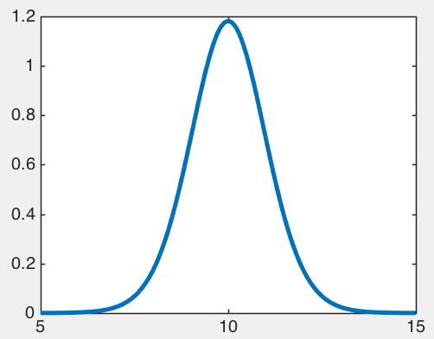
H₀: μ=10
H₁: μ≠10
Data: 11.1, 9.4, 9.9, 13.3, 10.3, …
x
Notes:
This is the actual formula for the t-distribution. You never need to know this formula, all you need to know is that there is such a thing as a t-distribution. So you can happily do as many t-tests as you want and never need to see this formula ever again.

Slide 102
t-test
The inputs are:
Data: 11.1, 9.4, 9.9, 13.3, 10.3, …
Null hypothesis: μ=10
Alternative hypothesis: ‘right’ tail (or ‘left’ or ‘both’)
Significance level: α=0.05.
Outputs are:
reject or not
p-value
(confidence interval)
Notes:
So how do you conduct a single sample t-test?
You don’t have to give it sigma, that’s not assumed to be known.

Slide 103
Tests for the mean
1 sample z-test
1 sample t-test (only use for n < 30 and normal)
Notes:
Ok so let’s go over when to use these tests.

Slide 104
Tests for the mean
1 sample z-test
1 sample t-test (only use for n < 30 and normal)
Use z-test when:
Data are normal, with σ known
n ≥ 30 (so the CLT kicks in and s≈σ)

Slide 105
Many other tests
Data: 11.1, 9.4, 9.9, 13.3, 10.3, …
Tests on median (sign test, Wilcoxon signed rank test)
Tests on variance (chi-squared)
Tests on proportion (uses binomial/normal)
Data: 0, 1, 0, 1, 1, 1, 0, 1, 0, 0…
Notes:
Just look up which one you need to do and what the assumptions are. The options are pretty much always the same, you send in the data, tell it whether to do a right tailed test, left tailed test, or both, depending on your alternative hypothesis. Tell it what the null hypothesis is, and tell it the significance level, and off it goes doing the test for you.

Slide 106
Two-sample tests
Sample 1: 10.06, 11.40, 10.51, 8.62, …
Sample 2: 7.14, 7.12, 9.72, 10.41, ...
Does population 1 have a larger mean than population 2?

Slide 107
Two-sample t-test
The inputs are:
Sample 1: 11.1, 9.4, 9.9, 13.3, 10.3, …
Sample 2: 9.4, 6.7, 11.0, 10.5, 10.8, …
Which t-test to conduct
Null hypothesis: μ₁-μ₂=0
Alternative hypothesis: ‘right’ tail μ₁>μ₂
(or ‘left’ μ₁<μ₂ or ‘both’ μ₁≠μ₂)
Significance level: α=0.05.
Outputs are:
reject or not
p-value
(confidence interval)
Notes:
So how do you conduct a single sample t-test?
You don’t have to give it sigma, that’s not assumed to be known.

Slide 108
Which t-test to conduct?
Sample 1: 11.1, 9.4, 9.9, 13.3, 10.3, …
Sample 2: 9.4, 6.7, 11.0, 10.5, 10.8, …
Do you have independent samples?
Or do you have paired samples?
Notes:
So how do you conduct a single sample t-test?
You don’t have to give it sigma, that’s not assumed to be known.

Slide 109
Which t-test to conduct?
Sample 1: 11.1, 9.4, 9.9, 13.3, 10.3, …
Sample 2: 9.4, 6.7, 11.0, 10.5, 10.8, …
Do you have independent samples?
Or do you have paired samples?
Independent: random smokers, random non-smokers
Paired: each smoker paired with a non-smoker
Notes:
A telltale sign that you have independent random samples is when the number of observations in the two samples are different. To get paired samples, the experiment has to be conducted in a way that these pairs exist naturally, like a before and after or some other way that… the first observation of one sample naturally has some connection to the first observation of the second sample.
If your data are paired, you’re in really good shape, because you can conduct a matched pairs t-test. Let me show you that one. I’ll discuss independent samples in a minute, that gets much more complicated.

Slide 110
Matched pairs t-test
The inputs are:
Sample 1: 11.1, 9.4, 9.9, 13.3, 10.3, …
Sample 2: 9.4, 6.7, 11.0, 10.5, 10.8, …
Which t-test to conduct: matched pairs t-test
Null hypothesis: μ₁-μ₂=0
Alternative hypothesis: ‘right’ tail μ₁>μ₂
(or ‘left’ μ₁<μ₂ or ‘both’ μ₁≠μ₂)
Significance level: α=0.05.
Outputs are:
reject or not
p-value
(confidence interval)
Notes:
Simple simple.

Slide 111
Matched pairs t-test
Sample 1: 11.1, 9.4, 9.9, 13.3, 10.3, …
Sample 2: 9.4, 6.7, 11.0, 10.5, 10.8, …
Independent Samples:
Can you assume the variances between two populations are equal?
Notes:
Can you assume this, even if you don’t know the variances?

Slide 112
Two independent samples t-test
The inputs are:
Sample 1: 11.1, 9.4, 9.9, 13.3, 10.3, …
Sample 2: 9.4, 6.7, 11.0, 10.5, 10.8, …
Which t-test to conduct: 2 independent samples t-test with equal variances (or unequal variances)
Null hypothesis: μ₁-μ₂=0
Alternative hypothesis: ‘right’ tail μ₁>μ₂
(or ‘left’ μ₁<μ₂ or ‘both’ μ₁≠μ₂)
Significance level: α=0.05.
Outputs are:
reject or not
p-value
(confidence interval)
Notes:
Now the calculation is actually different if you choose equal variances or unequal variances, so beware. If you choose equal variances, you are making a stronger assumption so the test will be more powerful. But if you choose unequal variances, you are making a less strong assumption, so your test won’t be as powerful, but at least in that case you’re not making untrue assumptions and it’s more likely that the result will hold.

Slide 113
Many other tests
Sample 1: 11.1, 9.4, 9.9, 13.3, 10.3, …
Sample 2: 1.4, 2.7, 9.2, 1.1, 7.2, ...
Wilcoxon Mann-Whitney U-test: tests whether one population’s values are generally larger than another’s. Does not assume normality.
Tests on proportion (uses binomial/normal)
Data: 0, 1, 0, 1, 1, 1, 0, 1, 0, 0…
Notes:
Just look up which one you need to do and what the assumptions are. The options are pretty much always the same, you send in the data, tell it whether to do a right tailed test, left tailed test, or both, depending on your alternative hypothesis. Tell it what the null hypothesis is, and tell it the significance level, and off it goes doing the test for you…. One of my favorite tests is the Fisher’s exact test which uses the hypergeometric distribution, I end up using that one a lot.

Slide 114
Hypothesis Testing Process
Notes:
Hypothesis testing is obviously a key topic in statistics. Hypothesis tests are used as a sort of data-centered technique to prove that something is true beyond a reasonable doubt. There’s been a lot of contraversy over hypothesis tests lately. There was a psychology journal that banned pvalues recently, and there was some real debate over this, sort of culminating with a letter from the American statistical association explaining what pvalues actually are and what they are not, warning people not to mess it up. There are multimillion dollar decisions being made based on pvalues every day. What drugs are safe for you to take, that depends somewhat on pvalues, and there are lawsuits every day about the interpretation of these pvalues. So let’s discuss it in a way that you can not only use it in your toolbox, but know when someone is using it incorrectly in theirs.

Slide 115
Practice
Which test to use?
Notes:
Ok so this is really the best way to learn hypothesis testing. Let’s go through a bunch of examples, and then we’ll try to figure out which test to use. Ready?

Slide 116
Practice
Which test to use?
I claim that the amount of toothpaste in a tube is normal, with mean 10 units. You say it’s not.
Measurements from each tube of toothpaste:
11.1, 9.4, 9.9, 13.3, 10.3, 12.2, 5.7, 8.1, 15.7, 9.1, 10.6, 9.2, 8.9, 12.7, 10.2, 10.8, 11.0, 9.5, 8.9, 12.3, 11.2, 10.3, 10.9, 14.8, 8.8, 10.3, 13.0, 10.2, 9.4, 8.9, 10.6, 9.3, 7.9, 12.5, 9.6, 10.1
Use a single sample t-test (or z-test), 2-sided. H₀: μ₁=10 , H₁: μ₁≠10.
Answer is we cannot reject.
Notes:
There are 36 points here. So what test do I use? I bought a bunch of containers of toothpaste, namely 36 of them, and measured how many units of toothpaste there were.

Slide 117
Practice
Which test to use?
I claim that the amount of toothpaste in a tube is normal, with mean 10 units. You say it’s not.
Measurements from each tube of toothpaste:
11.1, 9.4, 9.9, 13.3, 10.3, 12.2, 5.7, 8.1
Use a single sample t-test, 2-sided. H₀: μ₁=10 , H₁: μ₁≠10.
Again cannot reject.

Slide 118
Practice
The Major Trucking Company claims they generally have more trucks operating daily than the Worthwhile Trucking Company.
Major’s daily number of trucks :
111, 94, 99, 133, 103, 122, 57, 81, 157, 91, 106, 92, 89, 127, 102, 108, 110, 95, 89, 123, 112, 103, 109, 148, 88, 103, 130, 102, 94, 89, 106, 93, 79, 125, 96, 101
Worthwhile’s daily number of trucks :
101, 91, 96, 113, 91, 111, 72, 127, 92, 116, 90, 89, 126, 112, 108, 110, 95, 89, 123, 112, 128, 89, 100, 131
Use a t-test for 2 independent samples, unequal variances, right tailed. H₀: μ₁-μ₂=0. H₁: Right tailed, μ₁>μ₂.
Notes:
Clearly it’s independent samples since we have more measurements from one company than the other.
Here also the test turned out that we couldn’t reject the null hypothesis.

Slide 119
Practice
I claim that more than half of all women in Louisiana vote.
Survey of women voters:
1,0,1,1,0,0,1,1,1,0,1,0,1,0,1,1,0,1,0,1,0,1,1,0,0,0,1,0,1,1,0,1,0,1,0,0,1,0,0,1,0,1,0,0,0…
Use the binomial distribution to calculate the p-value, H₀: μ₁=0.5. H₁: Right tailed, μ₁>0.5.
Notes:
If the pvalue is below the level of significance alpha, then I reject the null hypothesis.

Slide 120
Practice
Telecommz claims that customers purchase more during the day than at night
 | Joe | Amy | Marie | Carl | Sam | Paul | Ari | Gemma | …
day | 30 | 25 | 45 | 27 | 32 | 12 | 4 | 12 | …
night | 25 | 86 | 12 | 28 | 31 | 30 | 0 | 3 | …
Use a t-test for paired samples, right tailed. H₀: μ₁-μ₂=0. H₁: Right tailed, μ₁>μ₂.
Use a sign test for matched pairs.
Notes:
I’m not sure I buy that. Because I’m not sure I agree with the normality assumption here. Because I think some people purchase more than other people. There’s not necessarily a central limit theorem to kick in here, because we’re not adding them up, we’re considering them each separately. There can be groups of customers that behave very differently. You could have a cluster of customers that buys almost nothing, and another clump that buys lots of stuff. I’m just not buying it. So I might use a sign test, which is a test that assumes very little about the distributions. I might not get as power, but at least I didn’t make an untrue assumption, leading me to an untrue conclusion.

Slide 121
Practice
Gems Ahoy claims that the “pirate” marketing campaign works better than the “diamond” marketing campaign
Sales on days with pirate: 30, 25, 45, 27, 32, 12, 4, 12,...
Sales on days with diamond: 12, 2, 16, 10, 4, 21,…
Use a t-test for independent samples, right tailed. H₀: μ₁-μ₂=0. H₁: Right tailed, μ₁>μ₂.
Notes:
I’m not sure I buy that. Because I’m not sure I agree with the normality assumption here. Because I think some people purchase more than other people. There’s not necessarily a central limit theorem to kick in here, because we’re not adding them up, we’re considering them each separately. There can be groups of customers that behave very differently. You could have a cluster of customers that buys almost nothing, and another clump that buys lots of stuff. I’m just not buying it. So I might use a sign test, which is a test that assumes very little about the distributions. I might not get as power, but at least I didn’t make an untrue assumption, leading me to an untrue conclusion.

Slide 122
Type 1 and Type II Errors
Notes:
Hypothesis testing is obviously a key topic in statistics. Hypothesis tests are used as a sort of data-centered technique to prove that something is true beyond a reasonable doubt. There’s been a lot of controversy over hypothesis tests lately. There was a psychology journal that banned p-values recently, and there was some real debate over this, sort of culminating with a letter from the American statistical association explaining what p-values actually are and what they are not, warning people not to mess it up. There are multimillion dollar decisions being made based on p-values every day. What drugs are safe for you to take, that depends somewhat on p-values, and there are lawsuits every day about the interpretation of these p-values. So let’s discuss it in a way that you can not only use it in your toolbox, but know when someone is using it incorrectly in theirs.

Slide 123
Errors
A type I error is made when a test rejects H₀ in favor of H₁ when H₀ is actually true (false positive).
E.g. person does not have the disease but test is positive.
A type II error is made when the test fails to reject H₀ when H₁ is true. (false negative).
E.g. person has the disease but test is negative.

Slide 124
Errors

Slide 125
Errors
The probability of a type I error is called the α-risk.
The probability of a type II error is called the β-risk.
That is:
α= P(type I error) = P(reject H₀ | H₀)
β= P(type II error) = P(fail to reject H₀ | H₁).

Slide 126
Misconceptions about Hypothesis Testing
Notes:
Hypothesis testing is obviously a key topic in statistics. Hypothesis tests are used as a sort of data-centered technique to prove that something is true beyond a reasonable doubt. There’s been a lot of controversy over hypothesis tests lately. There was a psychology journal that banned p-values recently, and there was some real debate over this, sort of culminating with a letter from the American statistical association explaining what p-values actually are and what they are not, warning people not to mess it up. There are multimillion dollar decisions being made based on p-values every day. What drugs are safe for you to take, that depends somewhat on p-values, and there are lawsuits every day about the interpretation of these p-values. So let’s discuss it in a way that you can not only use it in your toolbox, but know when someone is using it incorrectly in theirs.

Slide 127
Quiz: Misconceptions about Hypothesis Testing
From the ASA

Slide 128
Quiz: Misconceptions about Hypothesis Testing
T/F p-values indicate how incompatible data are with a specified model of the world.

Slide 129
Quiz: Misconceptions about Hypothesis Testing
T/F p-values indicate how incompatible data are with a specified model of the world.
True

Slide 130
Quiz: Misconceptions about Hypothesis Testing
T/F A p-value measures the probability that the null hypothesis is true.
Notes:
No way jose

Slide 131
Quiz: Misconceptions about Hypothesis Testing
T/F A p-value measures the probability that the null hypothesis is true.
False
Notes:
No way jose

Slide 132
Quiz: Misconceptions about Hypothesis Testing
T/F A p-value measures the probability that the data were produced by random chance alone.
Notes:
I have no idea what that means, random chance alone. No that’s not it. The pvalue has got to be thought of with respect to the null hypothesis.

Slide 133
Quiz: Misconceptions about Hypothesis Testing
T/F A p-value measures the probability that the data were produced by random chance alone.
False
Notes:
I have no idea what that means, random chance alone. No that’s not it. The pvalue has got to be thought of with respect to the null hypothesis.

Slide 134
Quiz: Misconceptions about Hypothesis Testing
T/F A pvalue below 0.05 is sufficient to base scientific conclusions or business decisions or policy decisions.
Notes:
Depends on how the study is done and whether there’s enough other evidence to make that decision. The pvalue is a piece of evidence (assuming someone didn’t manufacture the data to get the pvalue they wanted, which people do, obviously this is totally unethical, but people do it anyway).

Slide 135
Quiz: Misconceptions about Hypothesis Testing
T/F A pvalue below 0.05 is sufficient to base scientific conclusions or business decisions or policy decisions.
False
Notes:
Depends on how the study is done and whether there’s enough other evidence to make that decision. The pvalue is a piece of evidence (assuming someone didn’t manufacture the data to get the pvalue they wanted, which people do, obviously this is totally unethical, but people do it anyway).

Slide 136
Quiz: Misconceptions about Hypothesis Testing
T/F A pvalue measures how big an effect is. A small pvalue means a large effect.
Notes:
No way! Here’s an example.

Slide 137
Quiz: Misconceptions about Hypothesis Testing
T/F A pvalue measures how big an effect is. A small pvalue means a large effect.
n=10,000,000
Notes:
Here I’ve got n=10 million students, say they all go to a tutoring session. The tutoring session improves their score by

Slide 138
Quiz: Misconceptions about Hypothesis Testing
T/F A pvalue measures how big an effect is. A small pvalue means a large effect.
n=10,000,000
p-value=0.0001
Notes:
Here I’ve got n=10 million students, say they all go to a tutoring session. The tutoring session improves their score over the population mean by only 5 hundreths of a point. 5 hundreths. And then I could calculate the pvalue for testing whether the tutoring session improves their score above 0, and I might get

Slide 139
Quiz: Misconceptions about Hypothesis Testing
T/F A pvalue measures how big an effect is. A small pvalue means a large effect.
n=10,000,000
p-value=0.0001
Notes:
That the pvalue is .0001 so highly significant. So I’m really sure that the tutoring sessions improved their score. But whopdee do, yes it improved their score, and I’m really sure of it, but it only improved the score by a tiny little drop! So don’t get fooled by this one. The pvalue is not the size of the effect, no way, no how.

Slide 140
Quiz: Misconceptions about Hypothesis Testing
T/F A pvalue measures how big an effect is. A small pvalue means a large effect.
n=10,000,000
p-value=0.0001
False
Notes:
That the pvalue is .0001 so highly significant. So I’m really sure that the tutoring sessions improved their score. But whopdee do, yes it improved their score, and I’m really sure of it, but it only improved the score by a tiny little drop! So don’t get fooled by this one. The pvalue is not the size of the effect, no way, no how.

Slide 141
Quiz: Misconceptions about Hypothesis Testing
T/F A pvalue tells you how important a result is.
Notes:
The answer to this one should be obvious. If it doesn’t tell you

Slide 142
Quiz: Misconceptions about Hypothesis Testing
T/F A pvalue tells you how important a result is.
False
Notes:
The answer to this one should be obvious. If it doesn’t tell you how big the effect is, how can it tell you how important the result is?

Slide 143
Notes:
P-value is the first line of defense against being fooled by random chance. They are very helpful, and I suggest you use them… with caution.

